Slide 1
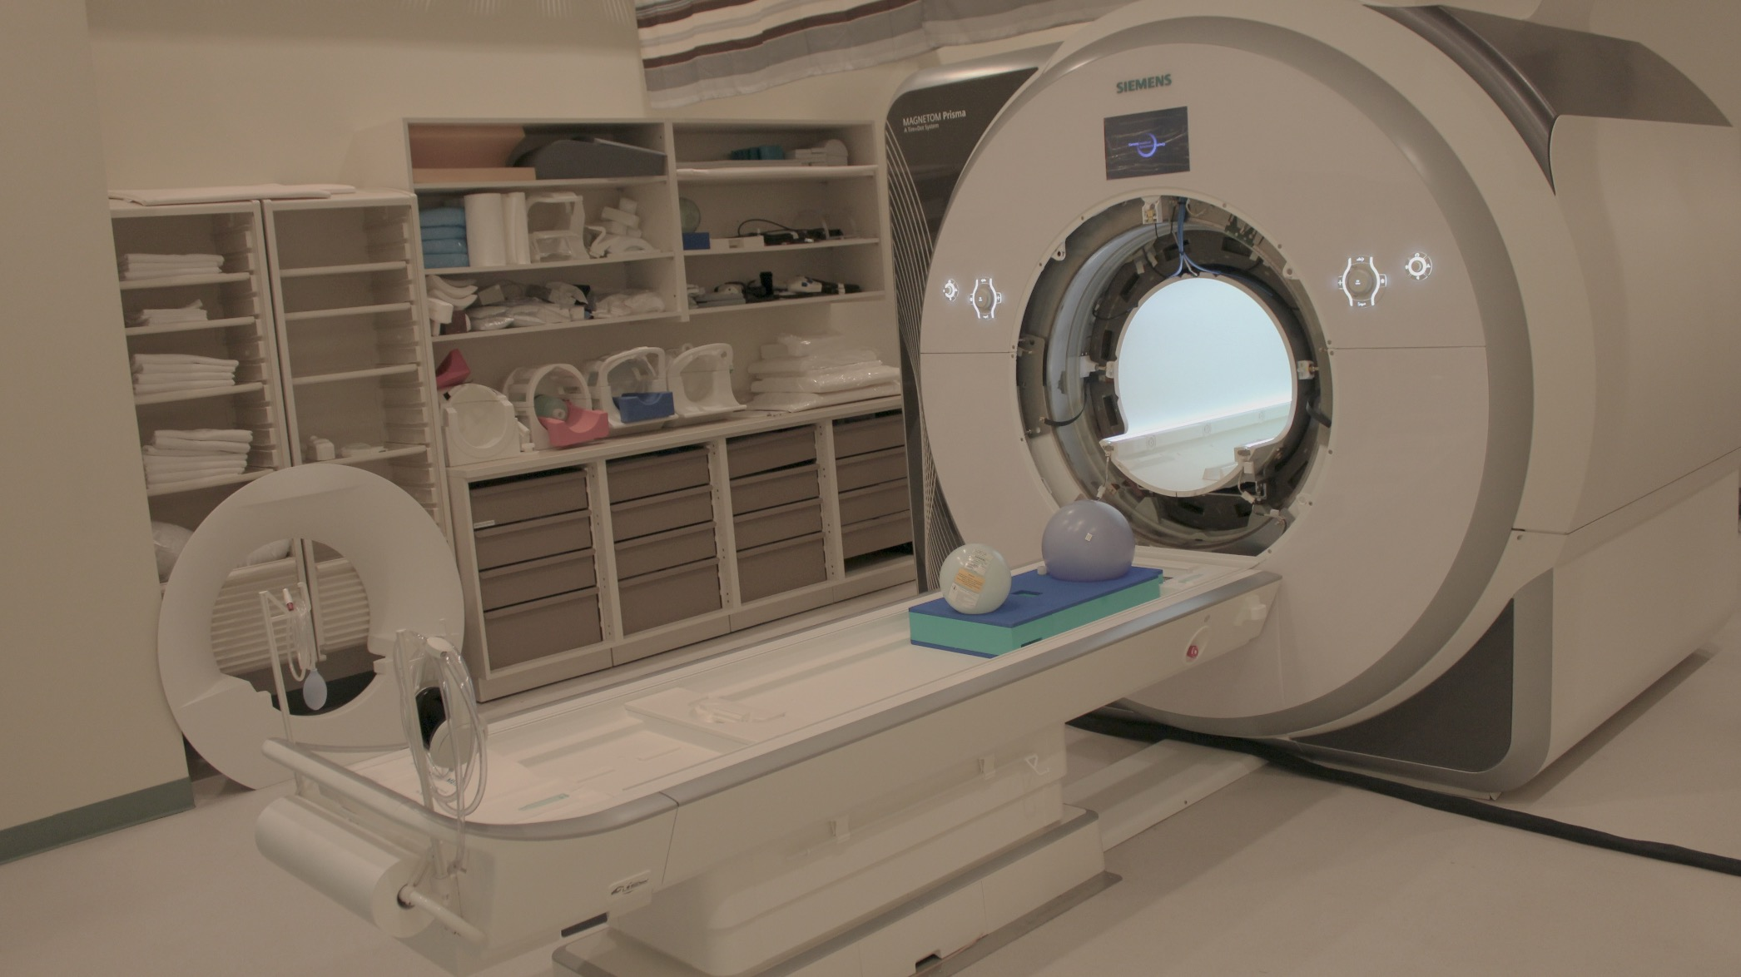
Local Eucalyptus Cloud for Enabling High Throughput Neuroimaging Analysis: Initial Experience
Brad Sutton
Assoc Prof, Bioengineering Department
Technical Director, Biomedical Imaging Center
Beckman Institute for Advanced Science and Technology
University of Illinois at Urbana-Champaign

Slide 2
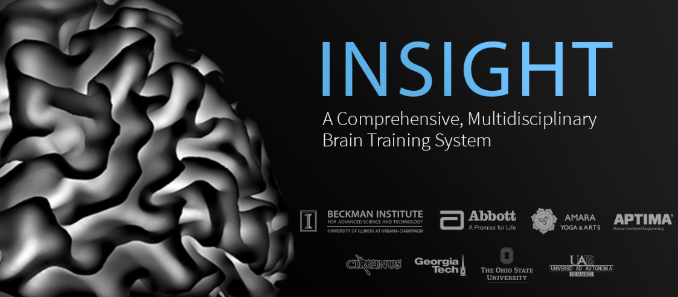
Need for scalable resources for neuroimaging data
Large data sets such as the 420-run IARPA-funded INSIGHT study at Illinois
Structural connectivity (Freesurfer, bedpostx, probtrackx) can take significant time per subject
Need to control software version used to analyze data across large groups of subjects and across the timeline of a project
Need scalable resources for once-in-a while analysis of entire data set
Need further scaling for “site visit imminent” analyses

Slide 3
Leverage Resources and Enable Further Scaling
NITRC-CE: Neuroimaging Informatics Tools and Resources Clearinghouse computational environment
Available on AWS
Interface is compatible, machines can be uploaded to AWS later
Eucalyptus: Elastic utility computing architecture for linking your programs to useful systems.
”For building Amazon Web Services compatible private and hybrid cloud computing environments.”
Free and open source (?!)

Slide 4
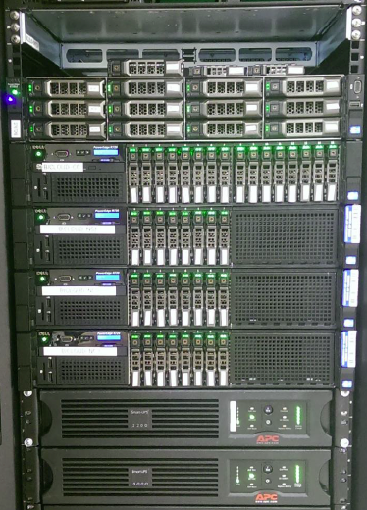
Our Implementation
4 Dell PowerEdge R720
2x10-core Intel Xeon CPUs
3 node controllers, cluster level components
60 cores for users
18 GB per core on NC
Dell PowerEdge R720xd
for cloud level components
Mellanox 56GbE – infiniband support

Slide 5
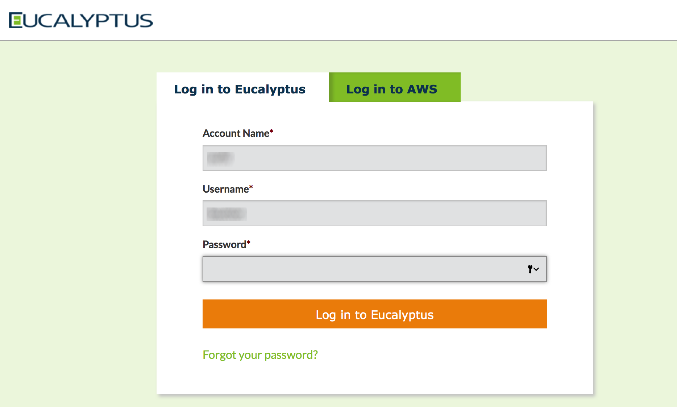
Eucalyptus 4.1.2

Slide 6
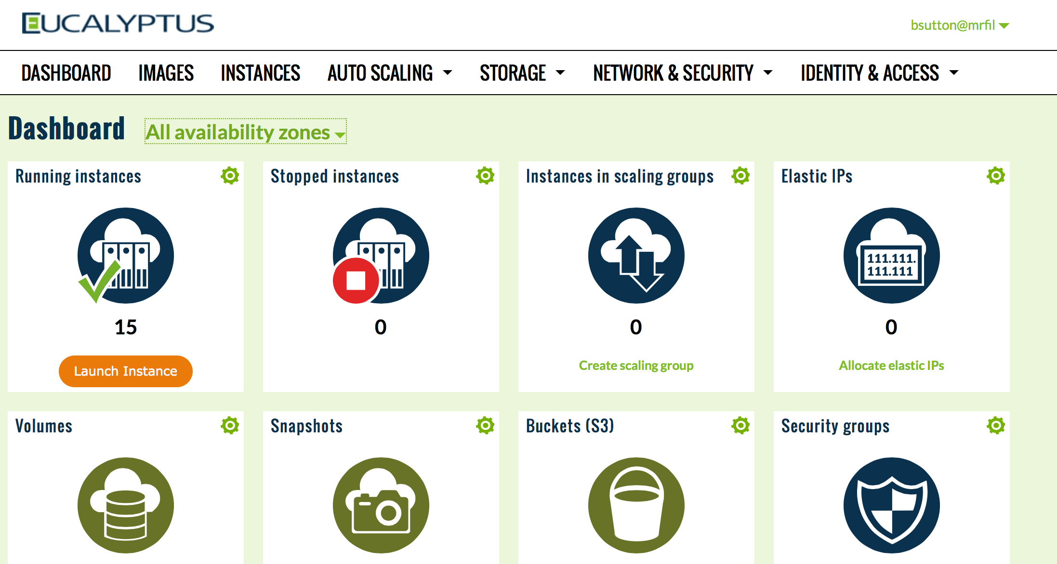

Slide 7
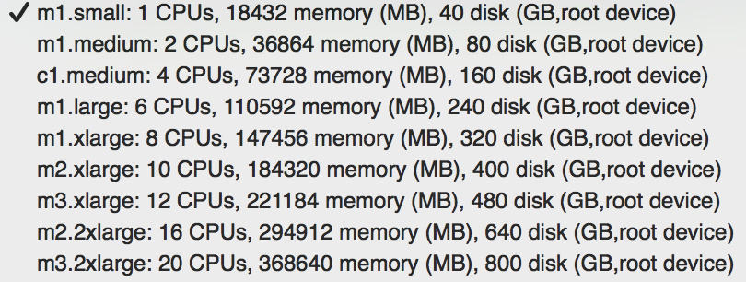
Launching an Instance

Slide 8
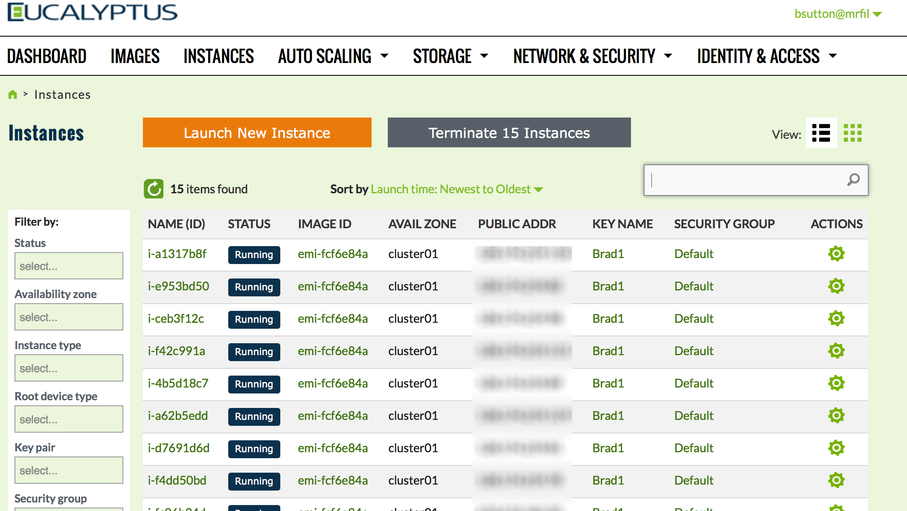

Slide 9
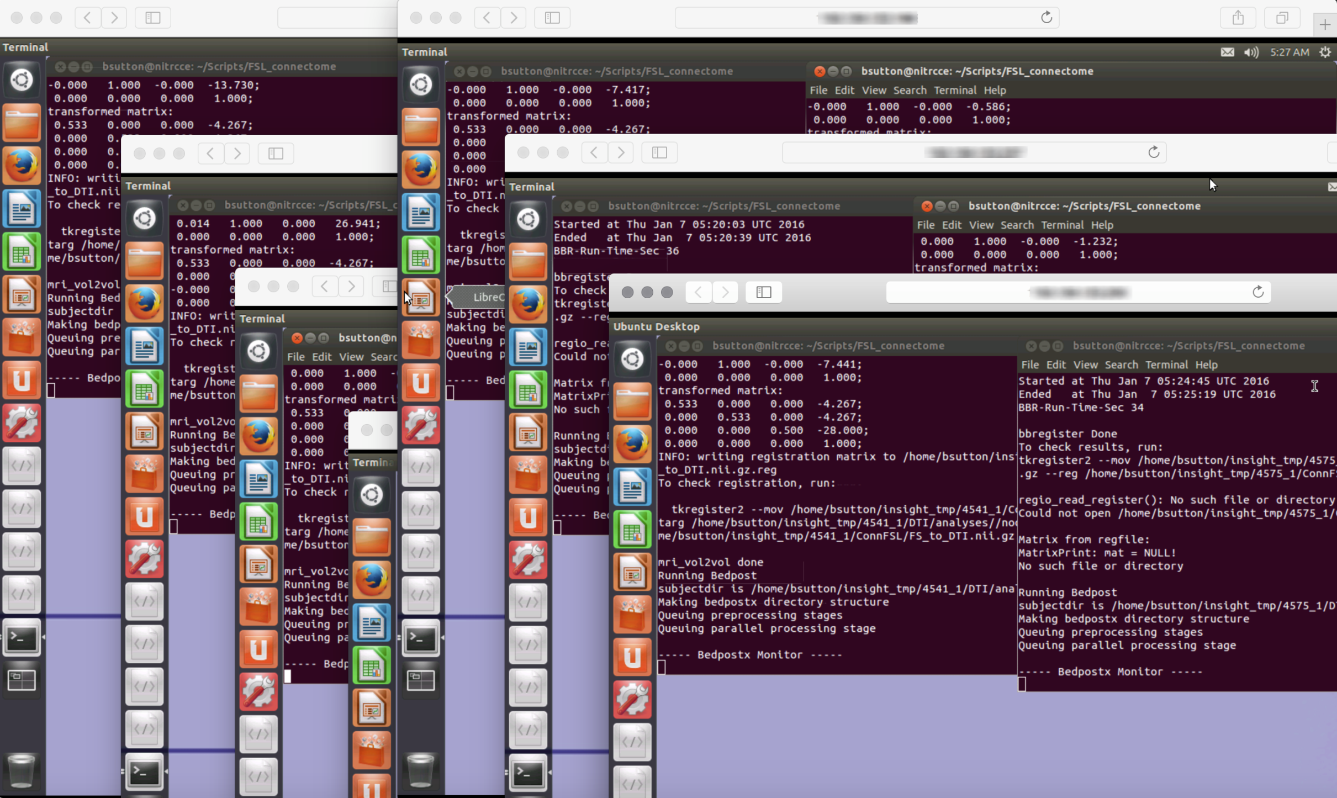
BICNICC: Neuroimaging Computing Cloud

Slide 10
Scaling up
Have run 420 subject/time point analyses multiple times
Freesurfer, bedpostx, probtrackx
Camino
Different parcellations, different probabilistic tractography options
3 weeks to run on 1/3 of private cloud
User scaling analysis to AWS
Import disk image, add AWS tools, move data S3 buckets instead of samba mount
Cost will be $5 per subject/time point

Slide 11
Conclusion
Resources provided with little risk will result in more analysis
Easy for neuroimaging center to standardize scripts, provide access to other resources, Nipype pipelines, etc.
Graphical interface to instances enables users who do not have experience with command line tools
Testing analysis routines in low risk environment has led to use of AWS for production run

